Slide 1
Design and implementation of a datawarehouse on the database "Northwind"
JAOUIRI Younes
BASTA Mohammed
MODULE : Business Intelligence
MASTER : Data Science
UNIVERSITY : Cadi Ayyad
Notes:
La durée totale de la présentation ne doit pas dépasser 15 minutes, une fois le délai dépassé la présentation sera interrompu

Slide 2
SOMMARY
Proposed decision requests
Proposed dimensional scheme
Data Integration
Scheme Mondrian
MDX queries
Datamining Analysis
Dashboard

Slide 3
Proposed decision requests
What is the average shipping time per country?
Which products are the most ordered by a customer?
What is the active customer of a year?
What are the most ordered products in a region at a season?
What is the average shipping time for each shipper?
What are the amounts of orders processed by employee and / or under his responsibility?
Which customers order the most?

Slide 4
Proposed dimensional scheme
Data bus matrix:
why did we choose the star schema?
Simply because the star pattern is more efficient due to the fact that there are fewer joints to make than a flake pattern and is simpler than the flake pattern.

Slide 5
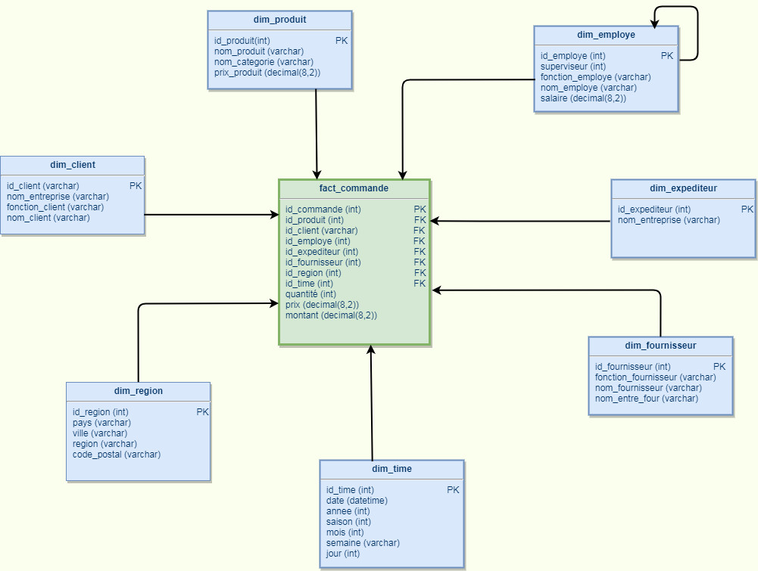
Proposed dimensional scheme

Slide 6
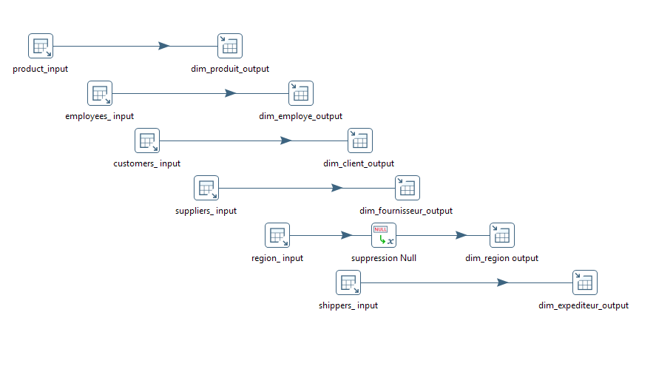
Data Integration
Creation of dimensions :

Slide 7

Data Integration
Création of dimension Région :

Slide 8
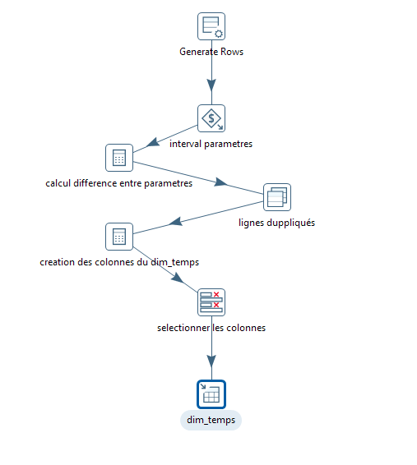
Data Integration
Création of dimension Temps (Time):

Slide 9
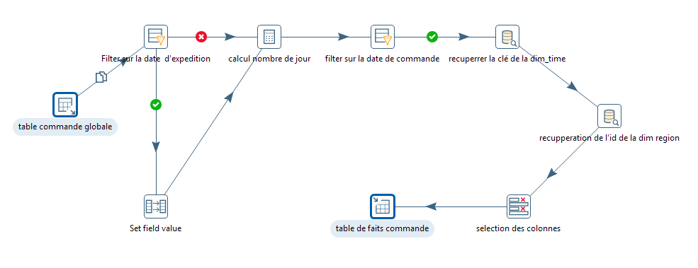
Data Integration
Creating the fact table Command:

Slide 10
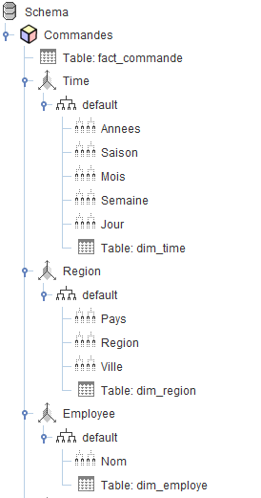
Scheme Mondrian
The TIME table contains a hierarchy: Years -> Season -> Month -> Week -> Day
The REGION table contains a hierarchy: Country -> Region -> City
The Employee table contains a parent-child hierarchy: (the notion of the supervisor) One level: Name

Slide 11
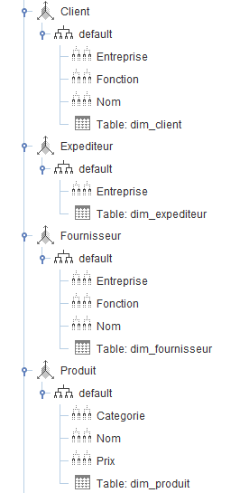
Scheme Mondrian
The CLIENT table contains a hierarchy: Company -> Function -> Name
The Sender table contains only one level: Factory
The Supplier table contains a hierarchy: Company -> function -> Name
The Product table contains the 3 levels: Category, Name and Price

Slide 12

Scheme Mondrian
The price measure shows the price of the product
The quantity measure calculates the quantity total order
The total measure is the amount of the order
The measure Nbr Delivery Day is the number of days after the order and before shipping

Slide 13
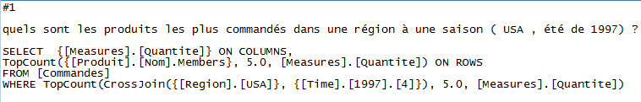
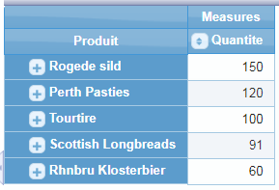
MDX queries

Slide 14
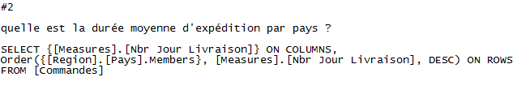
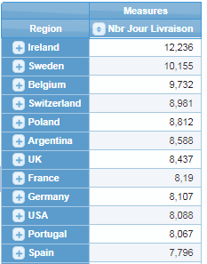
MDX queries

Slide 15
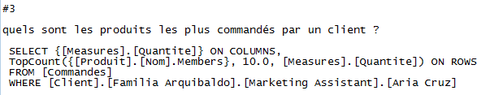
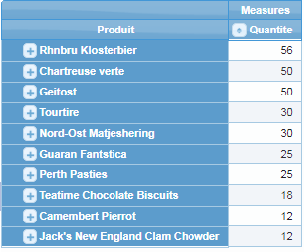
MDX queries

Slide 16
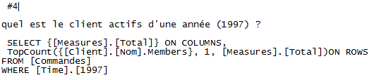

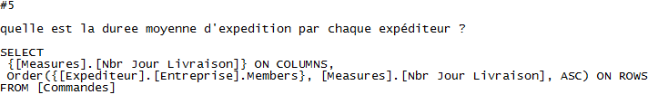
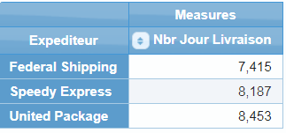
MDX queries

Slide 17
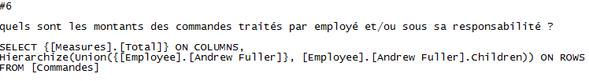
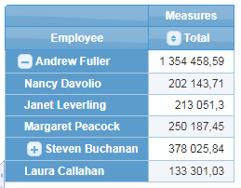
MDX queries

Slide 18
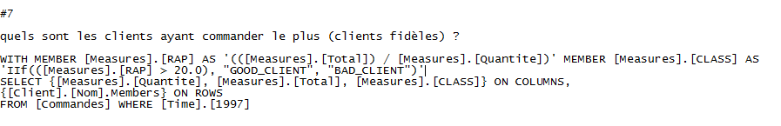
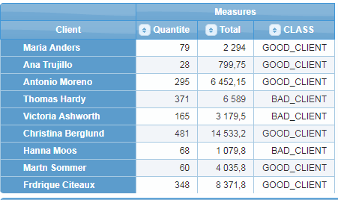
MDX queries

Slide 19
Datamining Analysis
We want to rank customers according to their purchases: good customers and low potential customers
the chosen attributes: Country, Quantity and amount

Slide 20
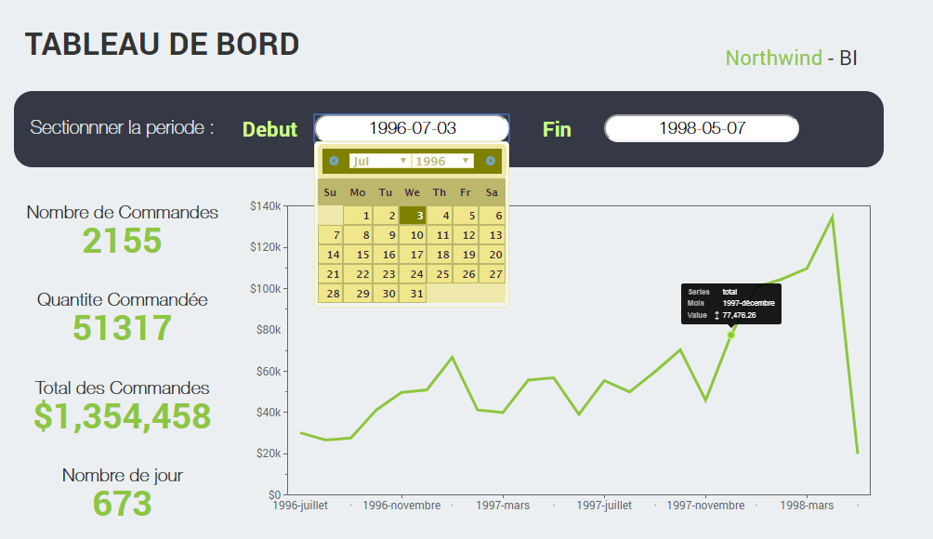
Dashboard

Slide 21
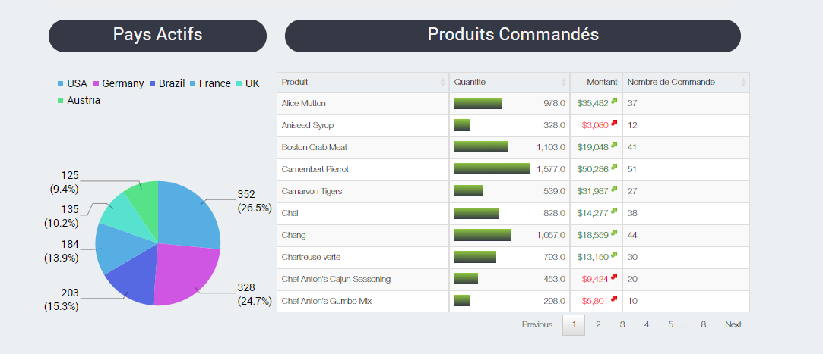
Dashboard

Slide 22
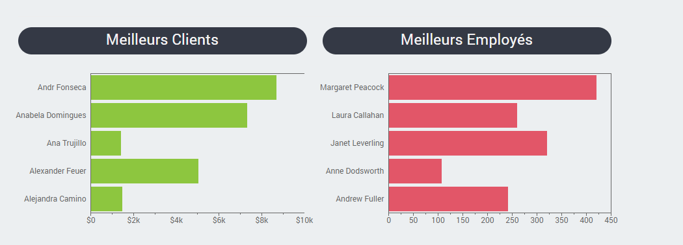
Dashboard

Slide 23
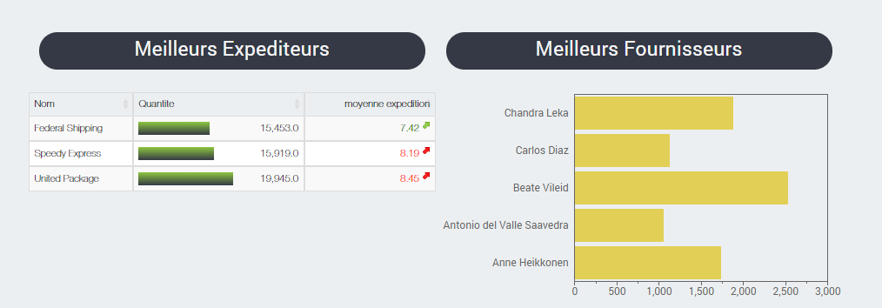
Dashboard

Slide 24
Demo

